Slide 1

Predicting MBTI Types from Spotify Playlists Using Machine Learning
Exploring the Intersection of Music Preferences and Personality
Author: Caleb White
Date: March 2, 2024

Slide 2
Project Overview
The goal is to predict MBTI types from Spotify playlists and my hypothesis was that music preferences can reflect personality traits.
This was a multi-class classification in supervised learning.

Slide 3
Dataset Features
Spotify MBTI Playlists by T. Le (2023) on Kaggle.
The dataset had multiple features, most notably: danceability, energy, and song keys. The target output variable was MBTI personality type.

Slide 4
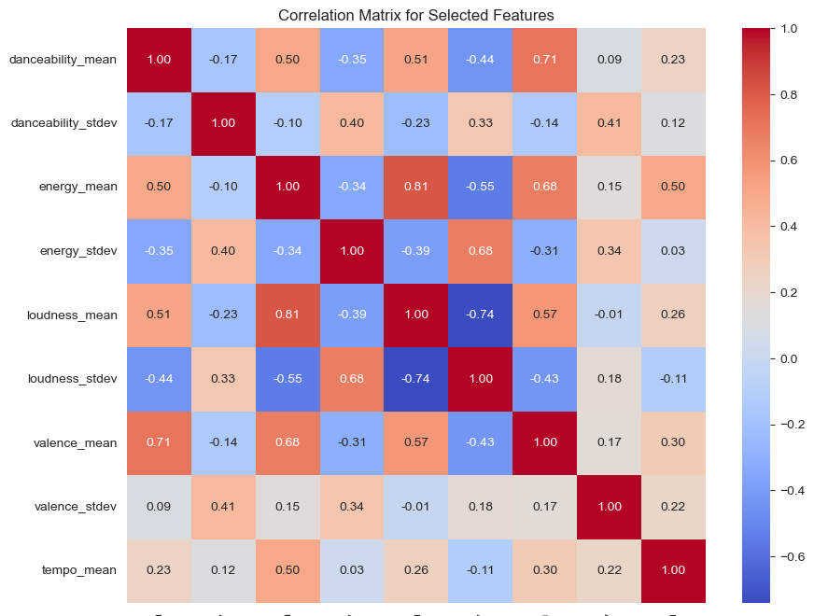
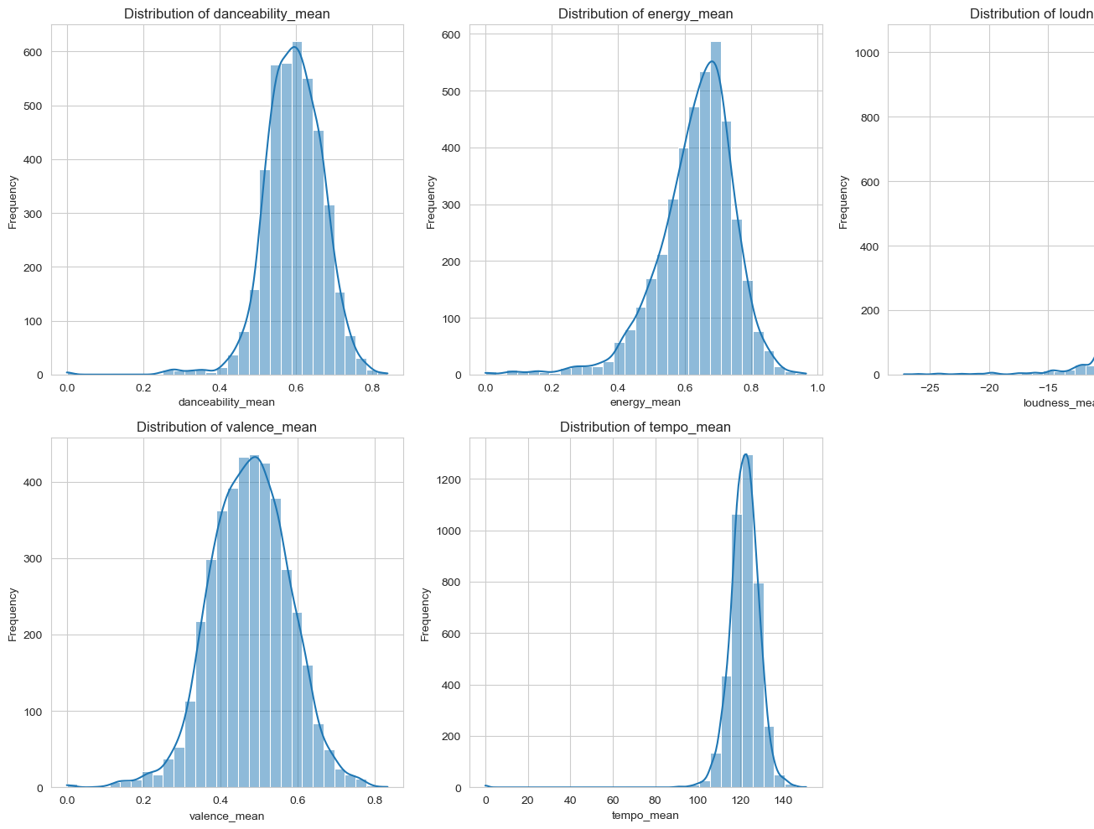
Exploratory Data Analysis (EDA)
Playlists skew towards danceable, louder tracks with diverse energy and mood.
Correlations reveal danceability positively impacts energy and mood, while loudness variation decreases with higher averages.

Slide 5
Modeling Approach
Strategy: Utilized cross-validation on a subset excluding ‘mbti’ column for model assessment.
Method: Streamlined preprocessing and model training with cross-validation to ensure generalization.
Random Forest Performance:
Cross-Validation Scores: [0.28, 0.26, 0.28, 0.28, 0.29]
Average Score: 0.278

Slide 6
Initial Modeling Results
SVM Performance:
Cross-Validation Scores: [0.28, 0.27, 0.29, 0.28, 0.31]
Average Score: 0.286
Observations:
Both Random Forest and SVM models show relatively low accuracy, highlighting the complexity of predicting MBTI types from Spotify playlists.
The challenge underscores the nuanced nature of correlating musical preferences with personality types in a multi-class classification setup.

Slide 7
Feature Engineering and Model Tuning
Feature Transformation: Applied transformations increased feature dimensions to 98, aiming for scale normalization.
Post-Transformation Scores:
Random Forest: Average CV Score decreased to 0.262.
SVM: Average CV Score slightly reduced to 0.274.
Insight: Both models experienced a performance dip after feature transformations, indicating potential overfitting.

Slide 8
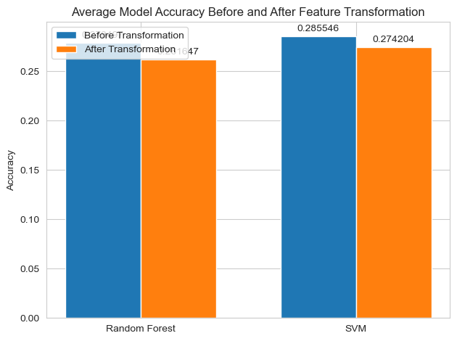
Final Model Comparison and Analysis
Model Performance Overview:
Before feature transformation:
Random Forest: 27.85% accuracy
SVM: 28.55% accuracy
After feature transformation:
Random Forest: Dropped to 26.16%
SVM: Decreased to 27.42%

Slide 9

Challenges, Learnings, & Future Direction
Challenges & Evaluation Metrics:
Addressed class imbalance by using F1 scores alongside accuracy.
Found the Random Forest model to have better balance of precision and recall with a macro-average F1 of 0.2765 and weighted-average F1 of 0.3056.
Learnings:
Feature engineering and model tuning are iterative and complex.
Future Directions:
Incorporate textual analysis for enriched feature sets.

Slide 10

Conclusion and References
Project Summary:
Explored the complex link between musical preferences and MBTI personality types.
Utilized Random Forest and SVM to predict personality types from Spotify playlists.
Faced challenges due to the complexity and abstract nature of psychological profiling through music.
References:
Le, T.(2023). Spotify MBTI Playlists. Kaggle. Retrieved January 17, 2024, from https://www.kaggle.com/datasets/xtrnglc/spotify-mbti-playlists

